Slide 1
A Professional Machine Learning Engineer designs, builds, and productionizes ML models to solve business challenges using Google Cloud technologies and knowledge of proven ML models and techniques. The ML Engineer collaborates closely with other job roles to ensure long-term success of models. The ML Engineer should be proficient in all aspects of model architecture, data pipeline interaction, and metrics interpretation. The ML Engineer needs familiarity with application development, infrastructure management, data engineering, and security. Through an understanding of training, retraining, deploying, scheduling, monitoring, and improving models, they design and create scalable solutions for optimal performance.

Slide 2
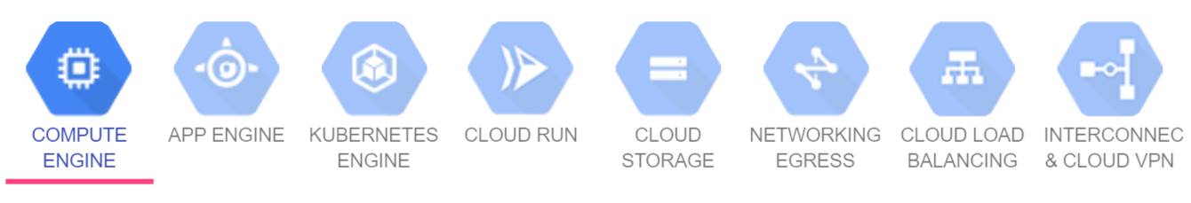
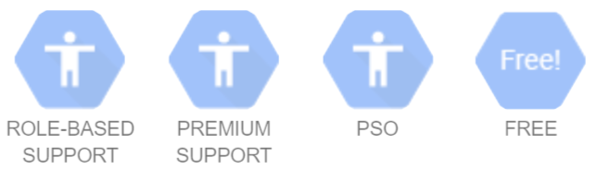
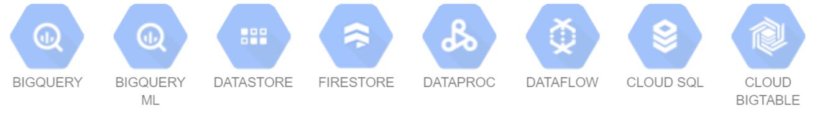
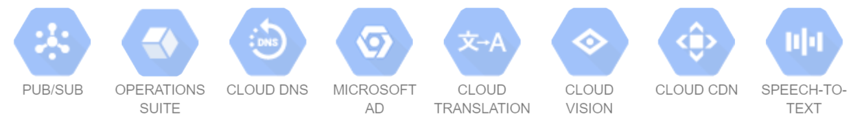
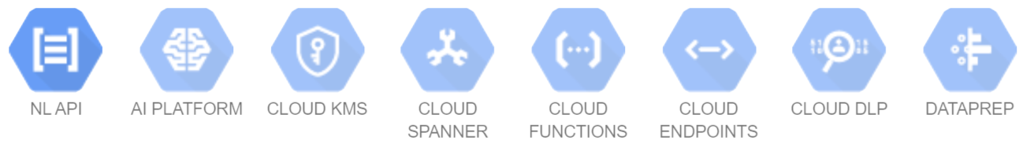
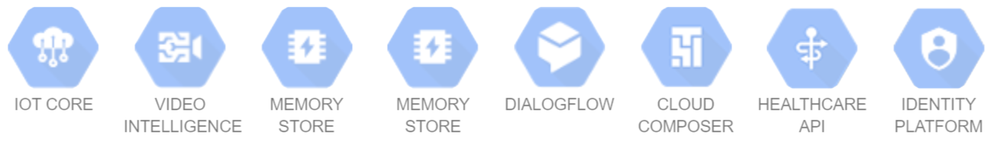
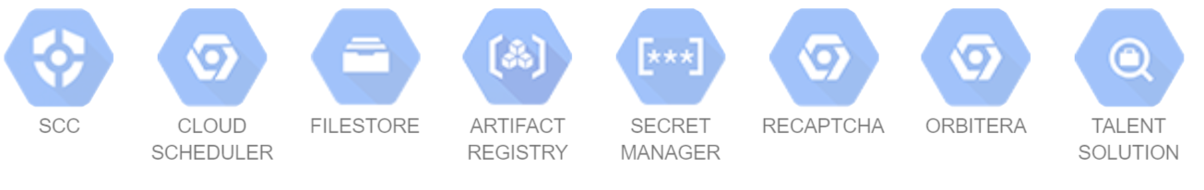

Slide 3
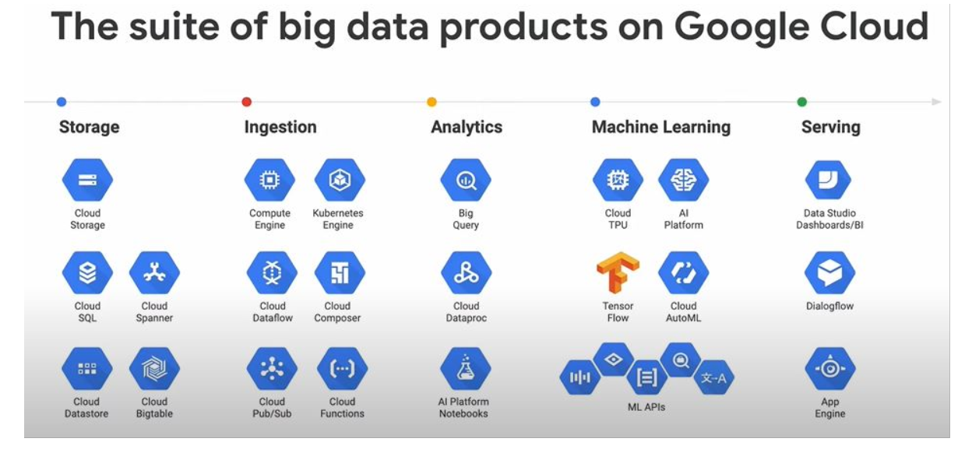

Slide 4
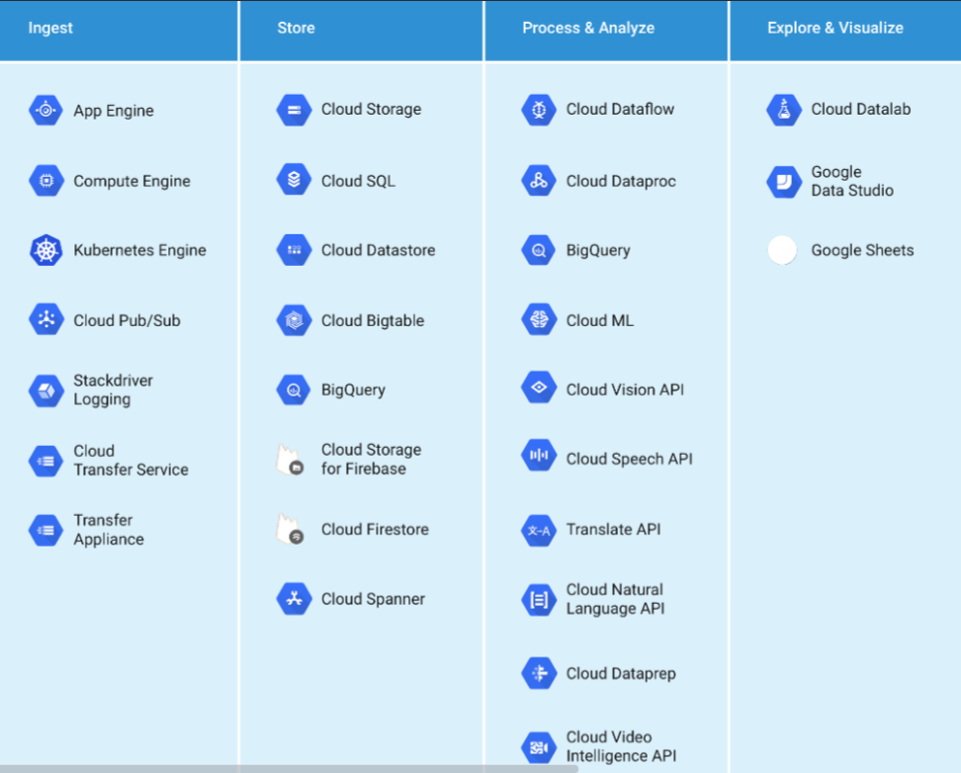

Slide 5
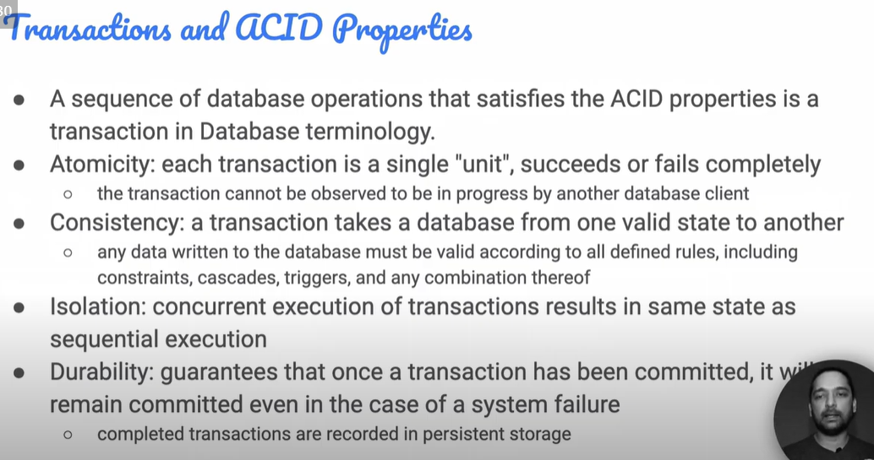
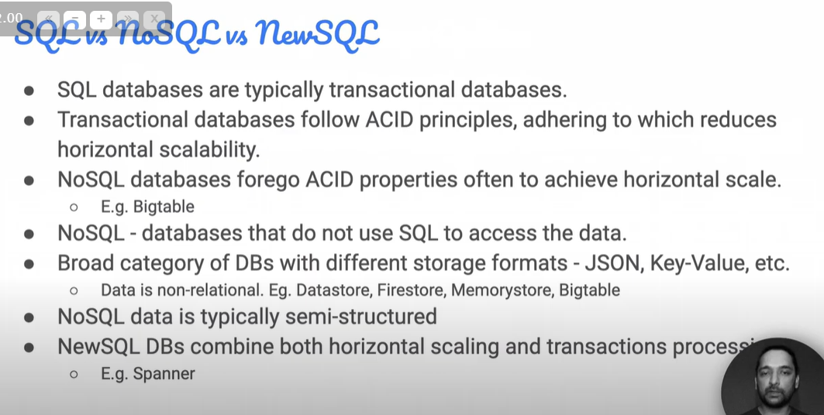

Slide 6
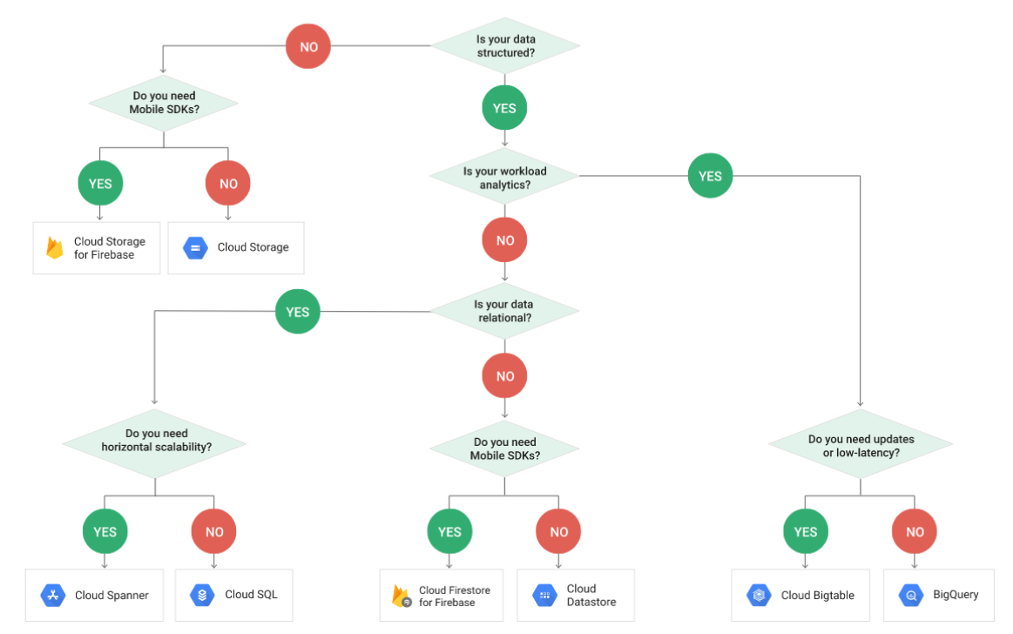

Slide 7
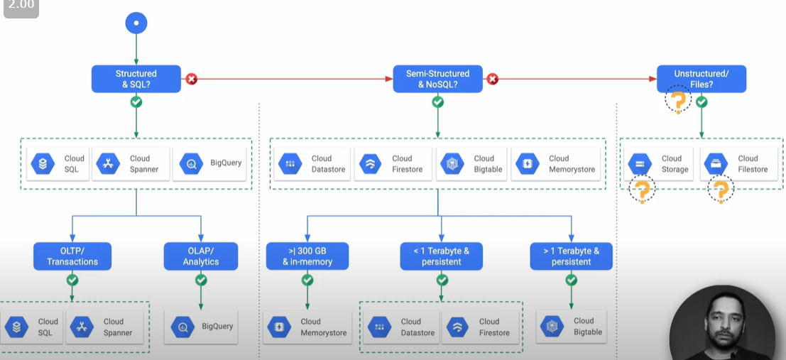

Slide 8
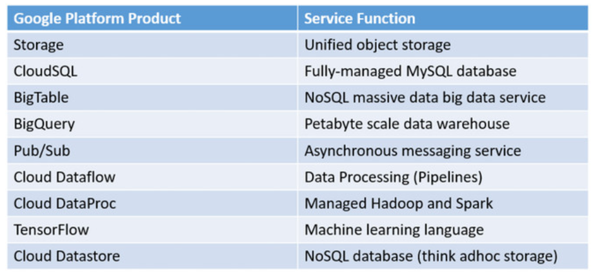
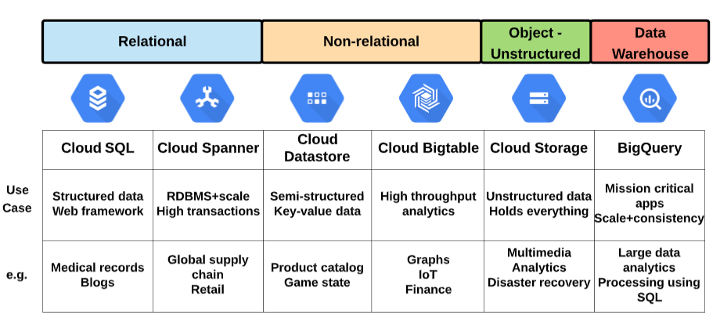

Slide 9
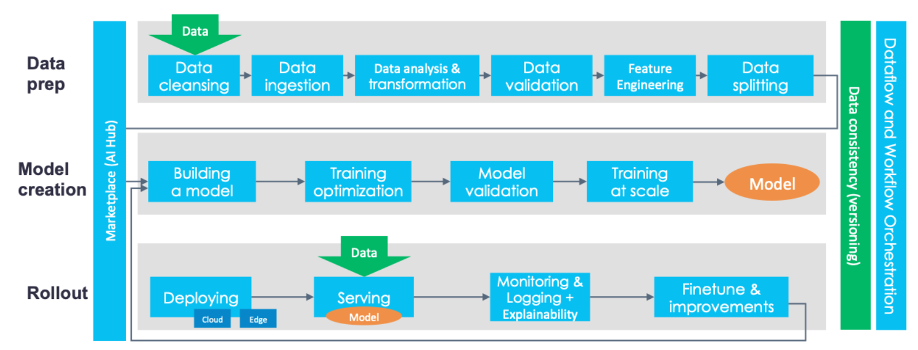
https://databaseline.tech/a-tour-of-end-to-end-ml-platforms/

Slide 10
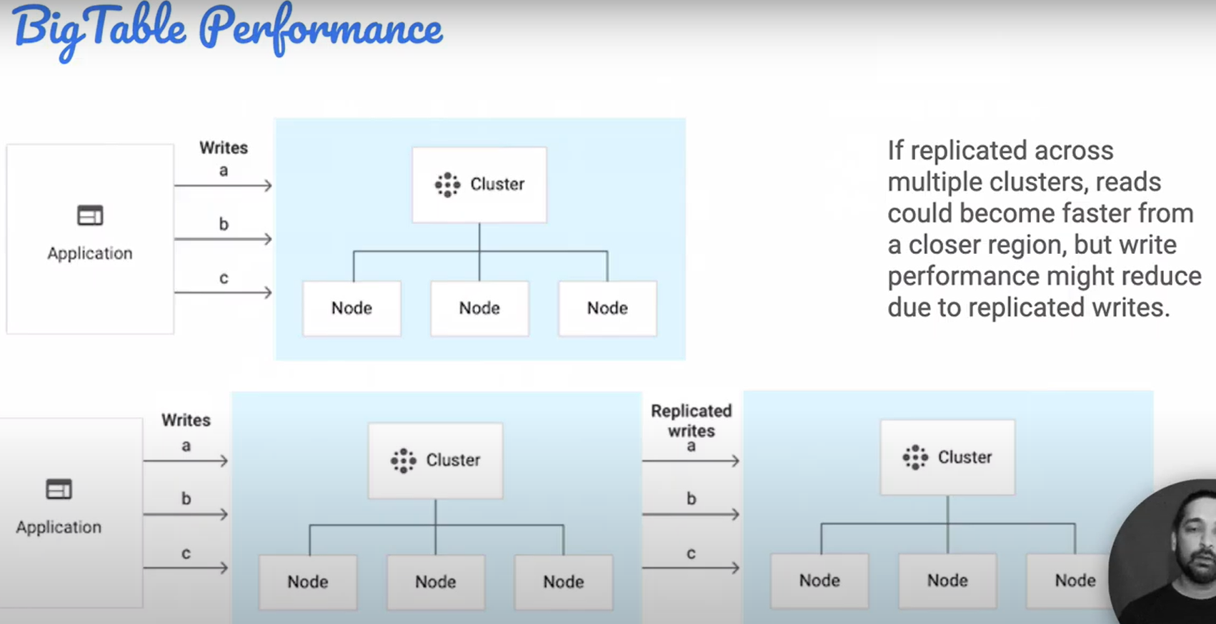

Slide 11
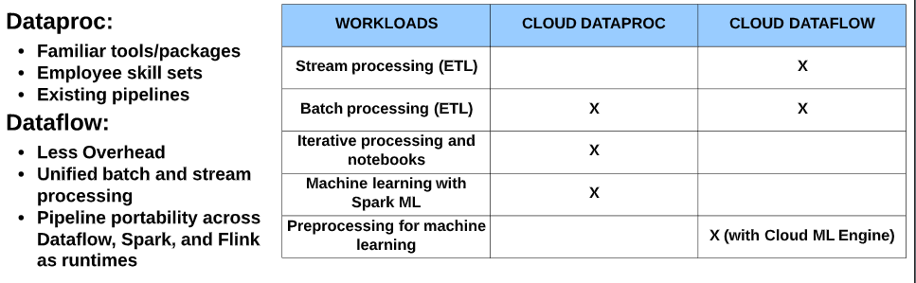
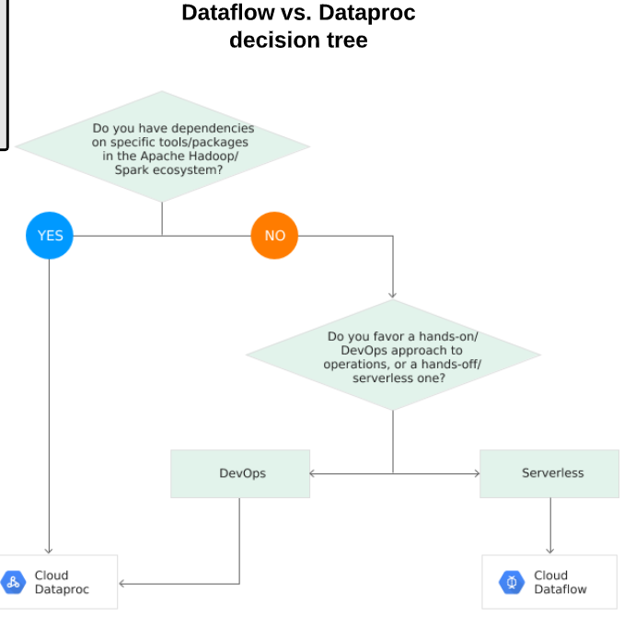
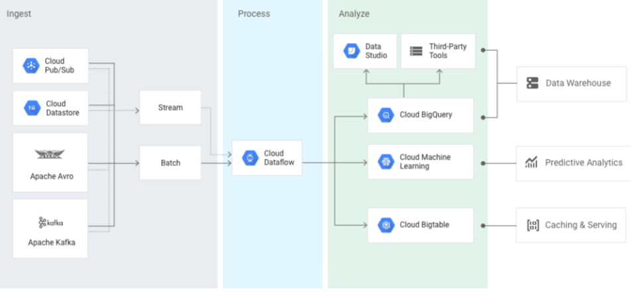

Slide 12
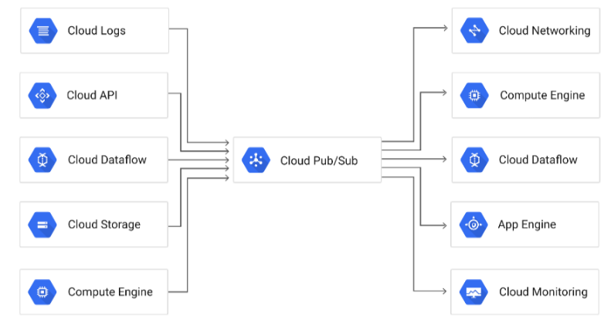
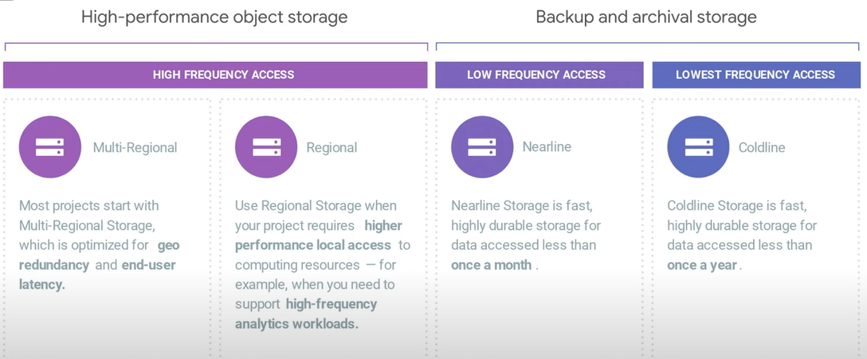

Slide 13
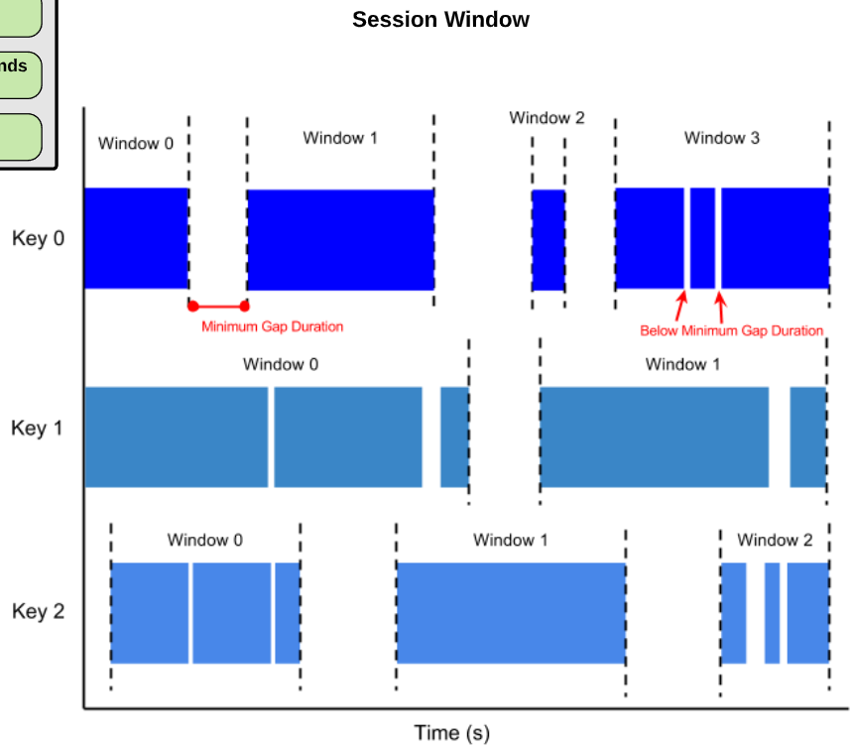
DataFlow

Slide 14
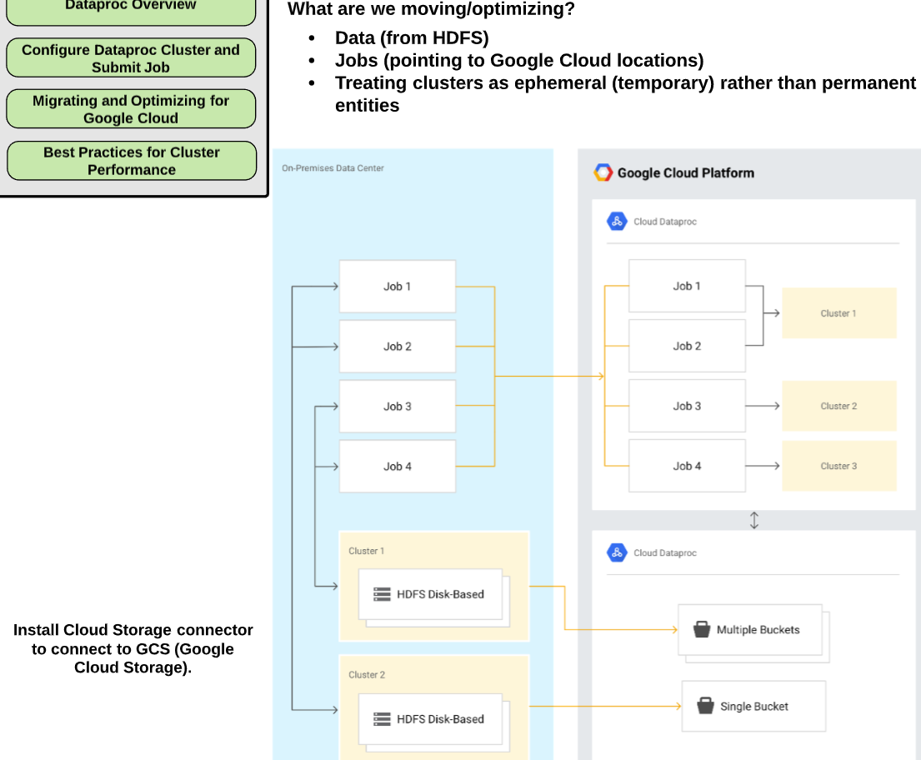

Slide 15
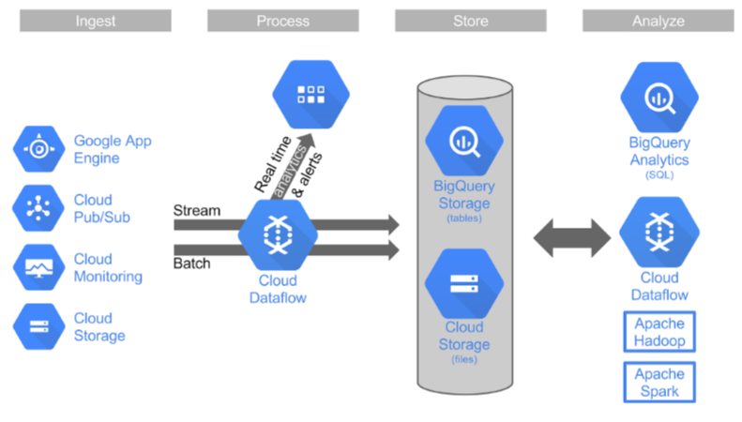
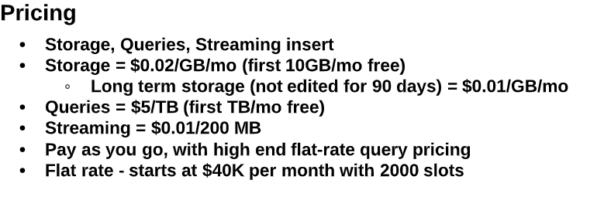
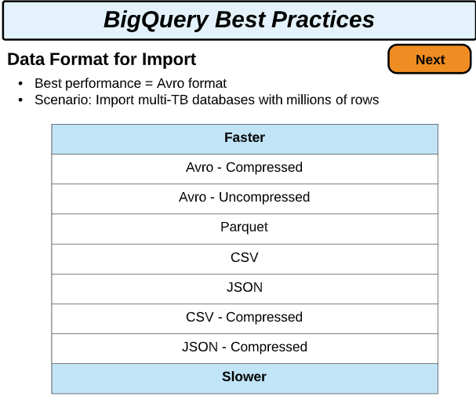
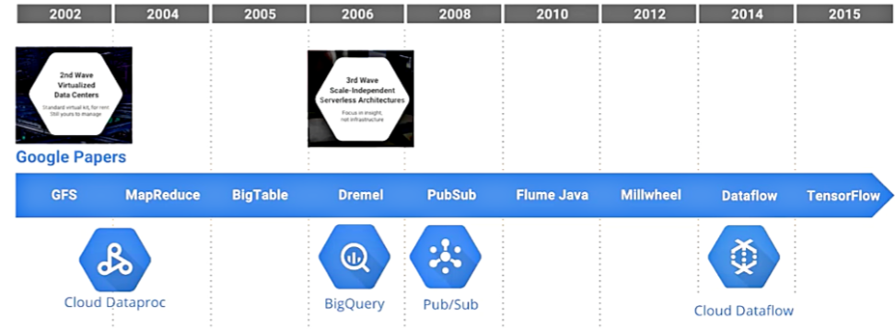

Slide 16
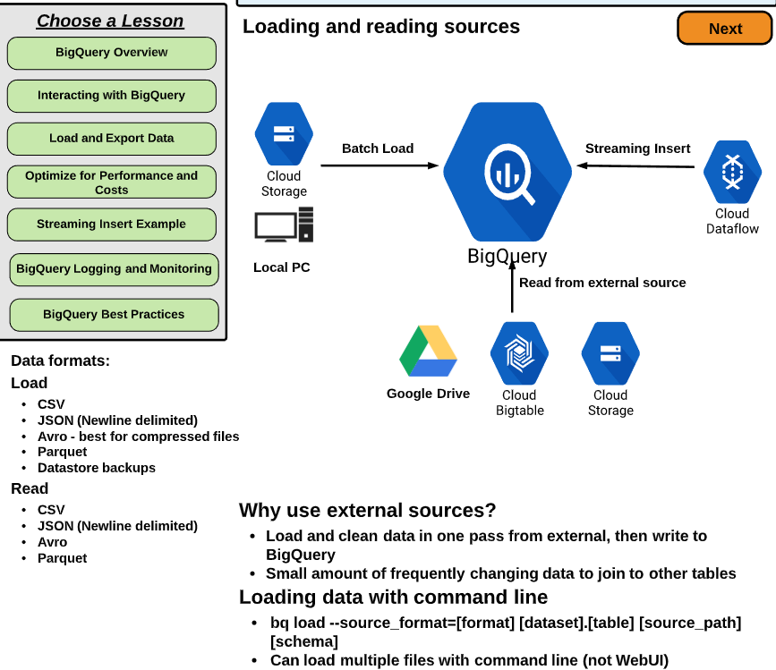
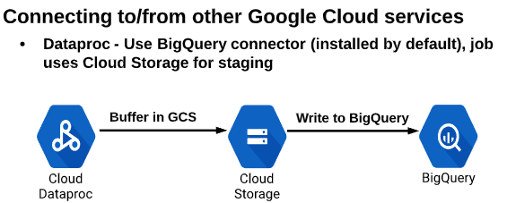

Slide 17
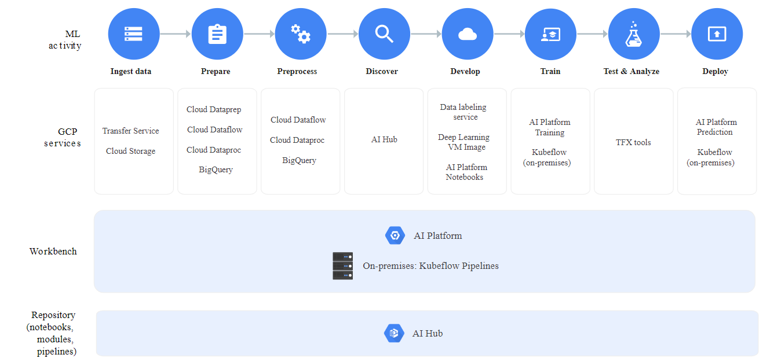

Slide 18
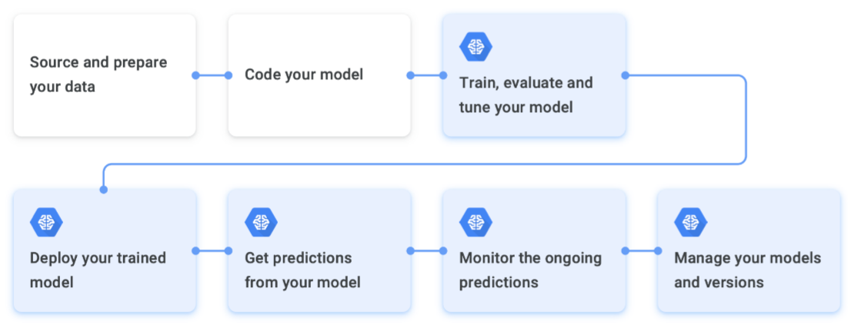
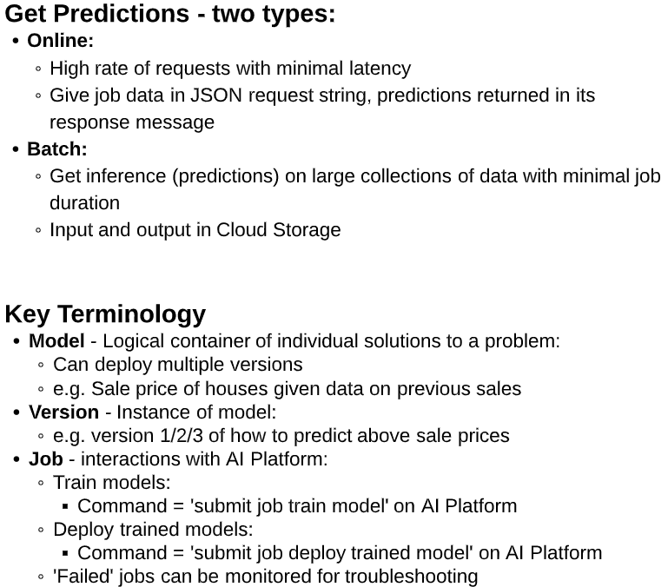
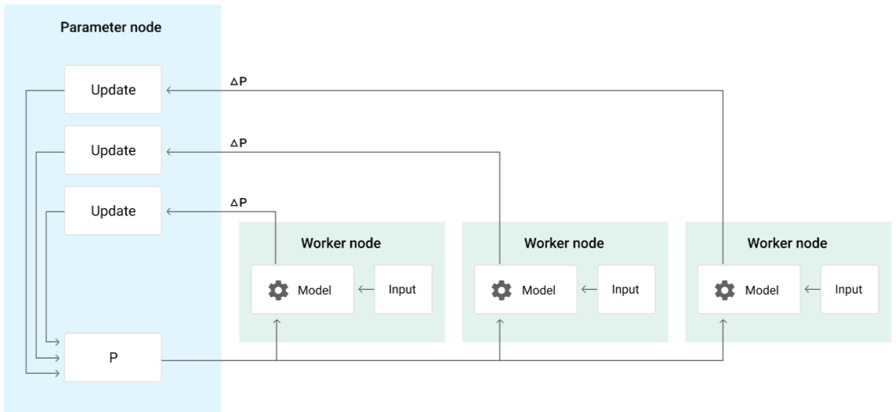

Slide 19
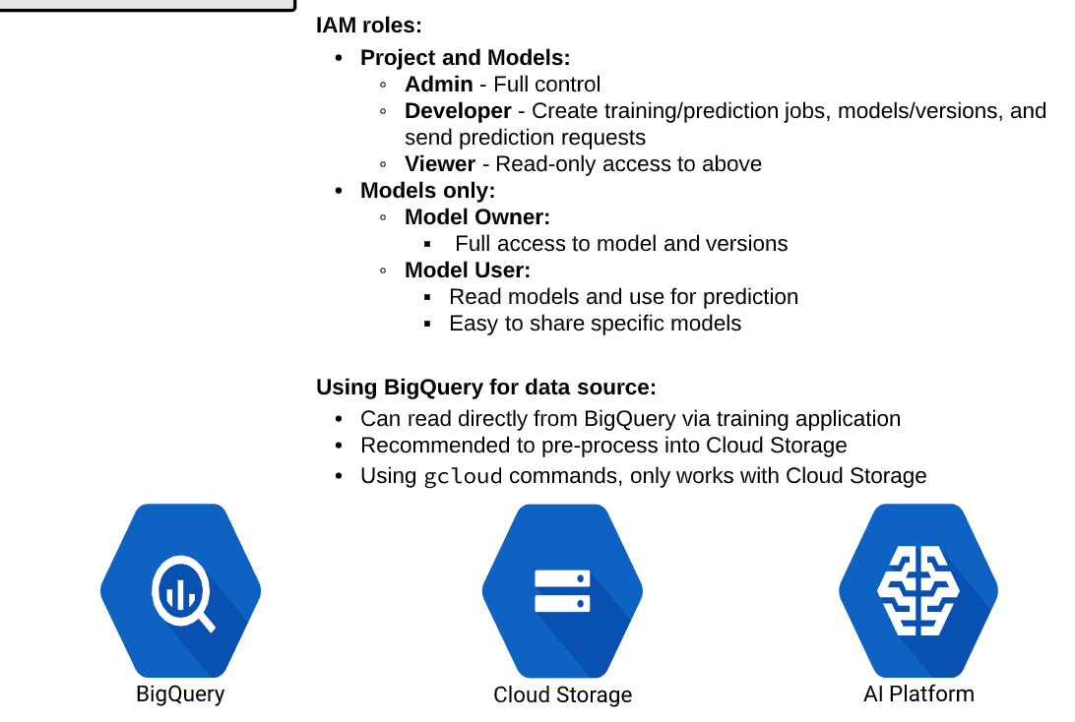
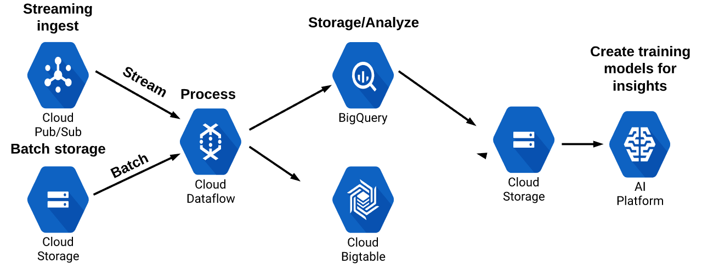

Slide 20
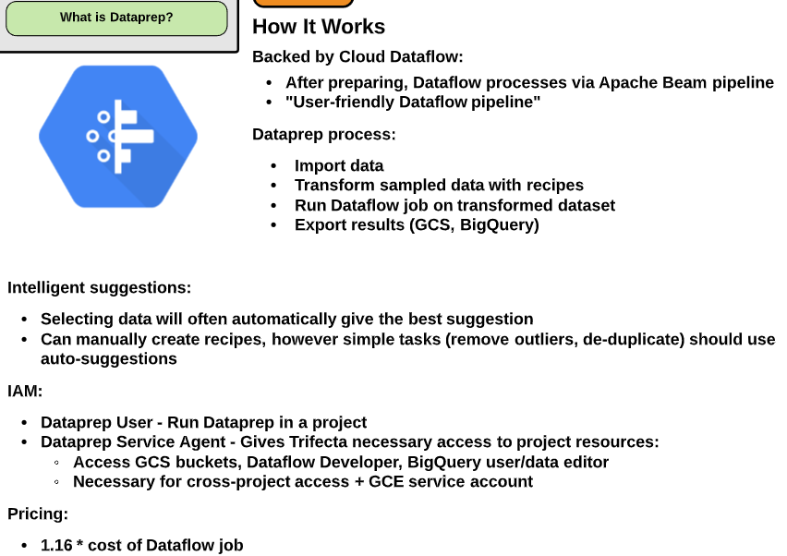

Slide 21
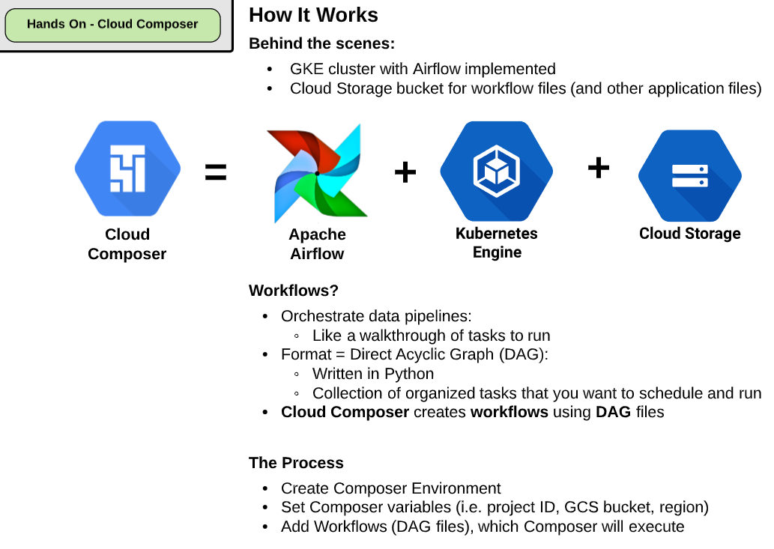

Slide 22
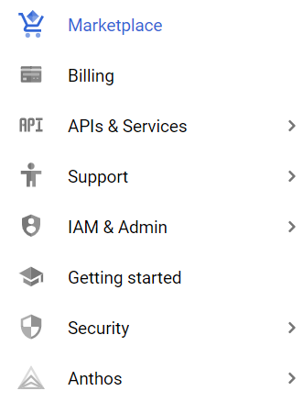
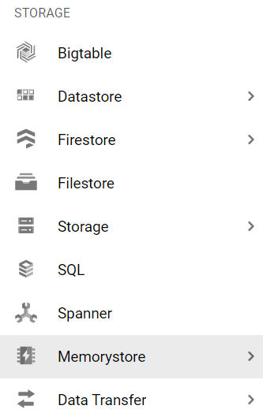
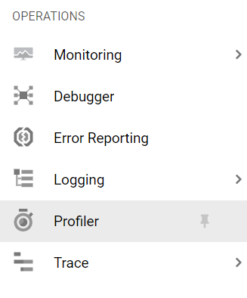
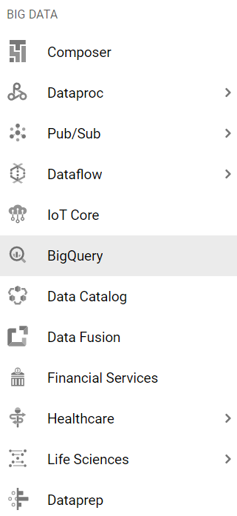
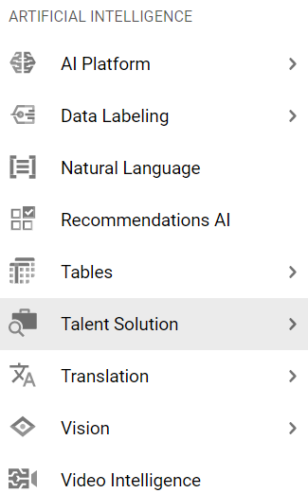
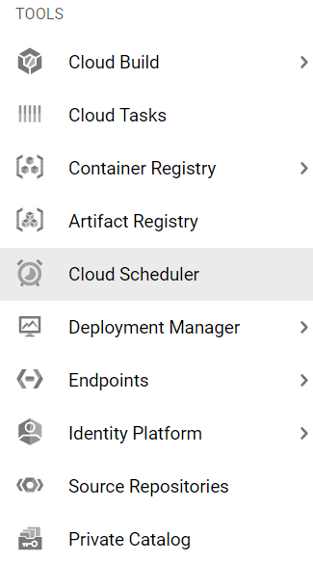
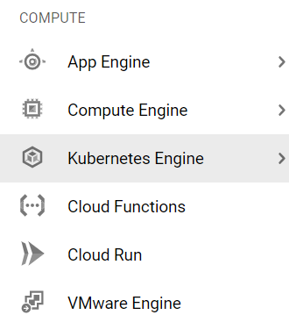
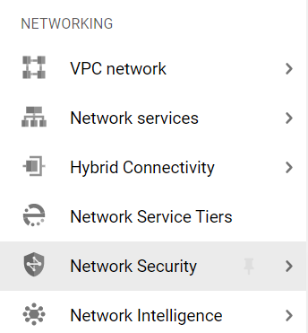
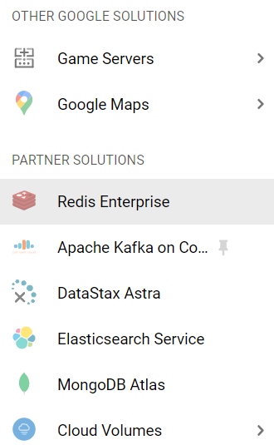

Slide 23
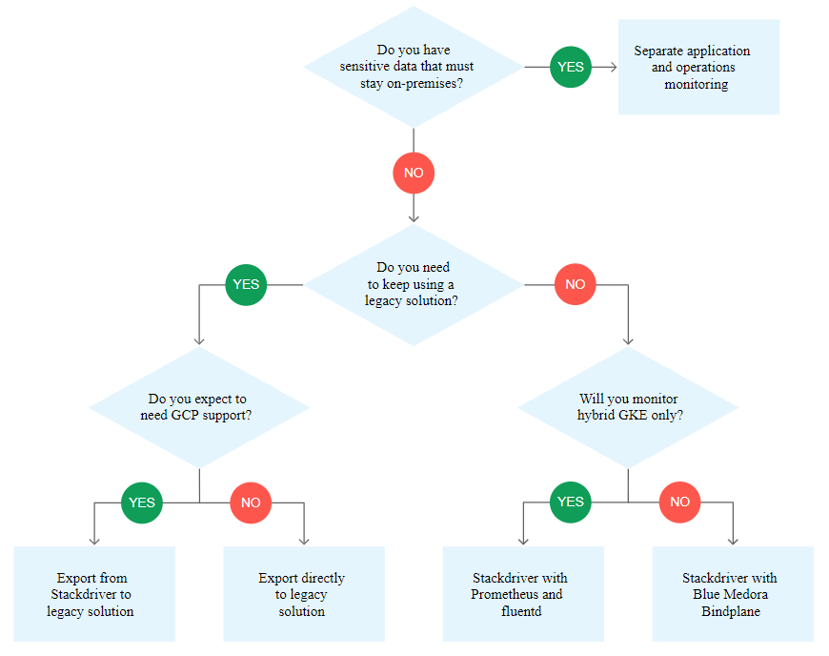

Slide 24
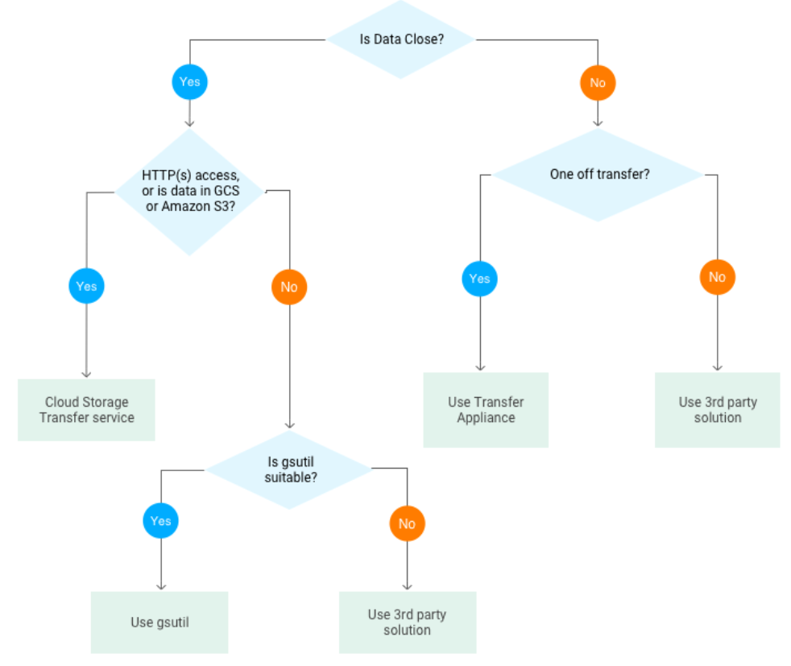

Slide 25
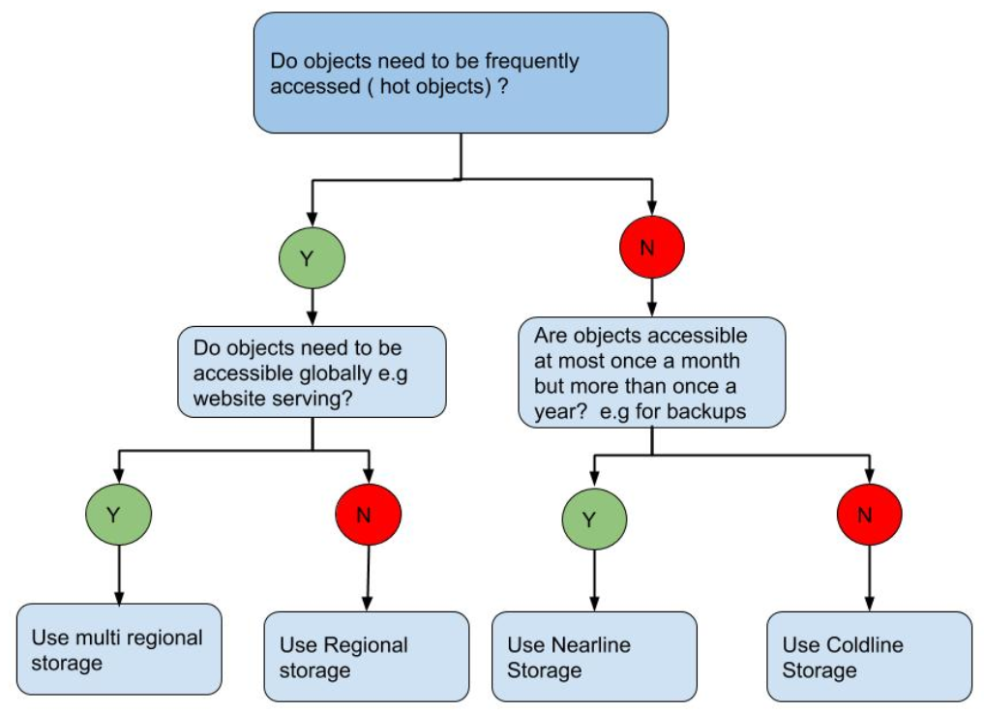

Slide 26


Slide 27
I took the exam today and there were 50 questions. The notes in the blog helped me to focus my study a lot; thanks! Here are my revisions as the exam isn’t a beta anymore:
Cloud Storage and Cloud Datastore – ~2 questions
Cloud SQL – ~2 questions
Bigtable – ~8 questions. How to optimize perf or troubleshoot slowdowns. What use cases would fit, etc.
BigQuery – ~8 questions. Data partitioning techniques, optimizing performance. Sharing data with other orgs. How to give list priv needed to users. How to avoid costly queries. Loading and differences of availability of data for streaming vs. batch.
Pub/Sub – ~3 questions. Basic knowledge was enough
Apache Hadoop – ~3 questions that were not GCP knowledge but Hadoop ecosystem knowledge; specifically pig and hive and what scenarios would push you to one or the other
Cloud Dataflow – ~8 questions. Understand batch and streaming designs. How to integrate with BigQuery and constraints you might have.
Cloud Dataproc – ~3 questions.
TensorFlow, Machine Learning, – ~10 questions that were mostly ML domain (and not TensorFlow specific) basically about training. Nothing about the Cloud ML service!
Cloud DataLab – ~2 questions about visualization, permissions/restricting access, creating dynamic dashboards
Stackdriver – ~1 question about auditing and viewing who did what in BigQuery
On both times I tried, it was heavy on BigQuery (20-25 questions) and TF/ML (10-15 questions), and spread out among the dataproc, dataflow and pubsub, with a couple of questions about SQL and datastore, and another couple of questions about general sysadmin/dba basic stuff. All the questions are scenario simulations where you have to choose which option would be the best way to deal with the situation, according to google standards and documentation. Be it choosing the right tech or the right way to configure it. They focus a lot on BigQuery's interaction with cloud storage and other solutions. What I didnt do much when studying the last two times was exercises and practicing with the solutions.I focused mainly on the theoretical stuff, and really thought I was doing well on my second try, specially since I was comfortably answering the BigQuery questions. But still failed... :( I'm focusing on hands-on practice now, and will try one last time on august.
I have summarized and would like to post what I have felt after I failed the test. Hope that this will help some ones. - The content of the exam covers all the knowledge about Google Cloud Platform (GCP) for Data Engineering, including: Storage (20% of questions), Big Data Processing (35%), Machine Learning (18%), case studies (15%) and others (Hadoop and security about 12%). - GCP Storage (20%): Covering knowledge about Cloud Storage, Cloud SQL, Data Store, Big Table and Big Query. To answer these questions, we need to deeply understand in which situation which storage technology is used to give us the best optimal solution. There are some questions related to design schema for Data Store and Big Table. - Big Data Processing (35%): Covering knowledge about Big Query, Cloud Dataflow, Cloud Dataproc, Cloud Datalab and Cloud Pub/Sub. There are many questions related to Dataproc and Dataflow in my test. In each question, each choice usually is a combination of some GCP technologies in order to create a solution, then we need to choose which solution is the best suitable (in technically, other solutions may be possible but not the best choice). - Machine Learning (18%): Covering knowledge on GCP API (Vision API, Speech API, Natural Language API and Translate API) and Tensorflow. I was a little bit surprised when there were fewer Machine Learning (ML) questions in my test than I expected. Problems and targets of some ML questions are not very clear and I felt vague on selecting the correct answer. - Case Studies (15%): There are 2 case studies which are as same as in the GCP website: a logistic Flowlogistic company and a communications hardware MJTelco company. Each case study includes about 4 questions which ask how to transform current technologies of that company to use GCP technologies. We can learn details about these case studies in LinuxAcademy. - Others (12%): Covering knowledge on Hadoop, and Security Issues. There are some questions that are out of the scope of the GCP Data Engineering, in my opinion, such as questions on Google Cloud Architect and Encryption technology of Security. In my opinion, these are difficult questions for my because I don't have background and GCP architect. To answer these questions, we need to prepare some knowledge in Google Cloud Architect. One notice is that there are some questions where we need to select multiple choices. For example, we need to select 3 answers from 6 choices. In such of case, the first and second choices are usually easier to select than the last choice.

Slide 28
Introduction Priocept consultants have recently been participating in the Google Cloud Platform beta certification exams. We have been working with Google Cloud Platform for many years – since the original launch of Google App Engine – but the new certification scheme allows us to formalize our consultants’ expertise on the platform. The “beta” nature of the exams means that our consultants have acted as Google guinea pigs to some degree. Very little study material or practice questions are available at the moment for the certification exams, and you have to rely on prior practical experience and reading the core documentation. So this blog article is intended to give an overview of the content for the Certified Data Engineer exam, as taken by our consultants in January 2017. The Data Engineer certification covers a wide range of subjects including Google Cloud Platform data storage, analytical, machine learning, and data processing products. Below we have given an overview, product-by-product, of what we were subjected to in the exam. Cloud Storage and Cloud Datastore Surprisingly, these products are not covered much in the exam, perhaps because they are covered more extensively in the Cloud Architect exam. Just know the basic concepts of each product and when it is appropriate (or not appropriate) to use each product, and you should be fine. Cloud SQL There were surprisingly few questions on this product in the exam. If you have practical experience using the product, you should be fine to answer any questions that do come up. As with questions related to other data storage products, be sure to know in what scenarios it is appropriate to use Cloud SQL and when it would be more appropriate to use Datastore, Bigquery, Bigtable, etc. Bigtable This product is covered quite extensively in the exam. You should at least know the basic concepts of the product, such as how to design an appropriate schema, how to define a suitable row key, whether Bigtable supports transactions and ACID operations, and you should also know (at least approximately) what the size limits for Bigtable are (cell and row size, maximum number of tables, etc). BigQuery Lots of questions on BigQuery in the Data Engineer exam, as expected. You should know about the basic capabilities of BigQuery and what kind of problem domains it is suitable for. You should also know about BigQuery security and the level at which security can be applied (project and datastore level, but not table or view level). Partitioned tables, table wildcard queries (“backtick” syntax), streaming inserts, query planning and data skew are also covered. You should also have an understanding of the methods available to connect external systems or tools to BigQuery for analytics purposes, how the BigQuery billing model works, and who gets billed when queries cross project and billing account boundaries. Pub/Sub The exam contains lots of questions on this product, but all reasonably high level so it’s just important to know the basic concepts (topics, subscriptions, push and pull delivery flows, etc). Most importantly you should know when it is appropriate to introduce Pub/Sub as a messaging layer in an architecture, for a given set of requirements. Apache Hadoop Technically not part of Google Cloud Platform, but there are a few questions around this technology in the exam, since it is the underlying technology for Dataproc. Expect some questions on what HDFS, Hive, Pig, Oozie or Sqoop are, but basic knowledge on what each technology is and when to use it should be sufficient. Cloud Dataflow Lots of questions on this product, which is not surprising as it is a key area of focus for Google with regard to data processing on Google Cloud Platform. In addition to knowing the basic capabilities of the product, you will also need to understand concepts like windowing types, triggers, PCollections, etc. Cloud Dataproc Not many questions on this besides the Hadoop questions mentioned above. Just be sure to understand the differences between Dataproc and Dataflow and when to use one or the other. Dataflow is typically preferred for a new development, whereas Dataproc would be required if migrating existing on-premise Hadoop or Spark infrastructure to Google Cloud Platform without redevelopment effort. TensorFlow, Machine Learning, Cloud DataLab The exam contains a significant amount of questions on this – more than we were expecting. Fortunately we have been busy working with TensorFlow and Cloud Datalab at Priocept for a while now. You should understand all the basic concepts of designing and developing a machine learning solution on TensorFlow, including concepts such data correlation analysis in Datalab, and overfitting and how to correct it. Detailed TensorFlow or Cloud ML programming knowledge is not required but a good understanding of machine learning design and implementation is important. Stackdriver A surprising numbers of questions on this, given that Stackdriver is more of an “ops” product than a “data engineering” product. Be sure to know the sub-products of Stackdriver (Debugger, Error Reporting, Alerting, Trace, Logging), what they do and when they should be used. Conclusion The Data Engineer certification exam is a fair assessment of the skills required if you want to be able to demonstrate the ability to work effectively with Google Cloud Platform on analytics, big data, data processing, or machine learning projects. If you have used the majority of these products already on real-world products, the exam should not present you with too many problems. If you haven’t yet used some of the products above, then get studying! If you take the exam and get caught out in any areas that we haven’t covered above, please let us know. Priocept provides both consultancy and bespoke training services for Google Cloud Platform, so please get in touch if we can help your organisation on your journey towards adopting the platform.

Slide 29




Slide 30



Slide 31






Slide 32





Slide 33




Slide 34



Slide 35



https://github.com/tensorflow/docs/blob/master/site/en/r1/guide/feature_columns.md

Slide 36




Slide 37


Slide 38



Slide 39


Slide 40

Option B: Dataflow

Slide 41


Slide 42



Slide 43


Slide 44


Slide 45





Slide 46




Slide 47


https://cloud.google.com/blog/products/ai-machine-learning/how-to-serve-deep-learning-models-using-tensorflow-2-0-with-cloud-functions

Slide 48


Slide 49

https://cloud.google.com/docs/authentication

Slide 50




Slide 51


Slide 52


Slide 53


Slide 54


Slide 55




Slide 56


Slide 57


Slide 58



Slide 59

https://blog.tensorflow.org/2018/09/introducing-tensorflow-data-validation.html

Slide 60

https://towardsdatascience.com/scaling-apache-airflow-for-machine-learning-workflows-f2446257e495

Slide 61





Slide 62


Slide 63



Slide 64


Slide 65


Slide 66

https://github.com/google/ml-metadata/blob/master/g3doc/get_started.md

Slide 67


Slide 68



Slide 69





Slide 70


Ingest types

Slide 71






Slide 72




Batch
Online (direct REST call)
Online (Dataflow invoke model)

Slide 73



Slide 74


Slide 75




Diagram mismatches text
Text says Pub/sub to client and Datastore to downstream

Slide 76



Slide 77



Slide 78


Slide 79



Slide 80



Slide 81





Slide 82



Stream
Direct is faster
Microbatch improves for any setup
Batch - Direct is faster for total time (can microbatch to improve) - AI Platform phase in 2 phase is fast but have to prepare data to json first in phase 1 so total time longer

Slide 83

https://cloud.google.com/solutions/automating-iot-machine-learning

Slide 84



Slide 85

https://cloud.google.com/solutions/machine-learning/setting-up-an-mlops-environment

Slide 86

MLOps level 1: Deploy whole training pipeline rather than trained model (level 0)

Slide 87



Slide 88



Slide 89

MLOps level 2: Pipeline is automatically build, test, package, deployed rather than manual (level 1)

Slide 90


Slide 91


Slide 92


Slide 93


Slide 94

https://www.tensorflow.org/extras/candidate_sampling.pdf

Slide 95


Slide 96




Slide 97


Slide 98




Slide 99


Slide 100


Slide 101




Slide 102



Slide 103



https://developers.google.com/machine-learning/crash-course/embeddings/translating-to-a-lower-dimensional-space
https://developers.google.com/machine-learning/glossary#embeddings

Slide 104


Slide 105




Slide 106



Slide 107


Slide 108







Slide 109





Slide 110




Slide 111



Slide 112






Testing for Deploying

Slide 113



Testing in Production

Slide 114


Slide 115


Slide 116



Slide 117


Slide 118









Slide 119





Slide 120


Slide 121

https://cloud.google.com/pubsub/docs/overview

Slide 122

Kubeflow Pipelines with AI Platform

Slide 123


